Slide 1
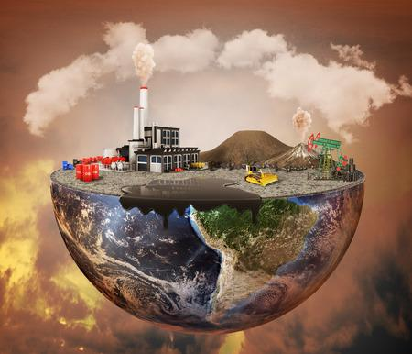

PROFESSIONAL COMMUNICATION ACTIVITY
POLLUTION
CREATED BY:
Melissa Manoj Thondoli
S2 CSE A
Roll No. - 47

Slide 2
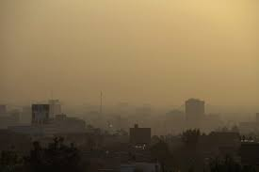
CONTENTS
What is Pollution?
4 Major types of pollution
Air Pollution
Water Pollution
Soil Pollution
Noise Pollution
Pollution Prevention

Slide 3
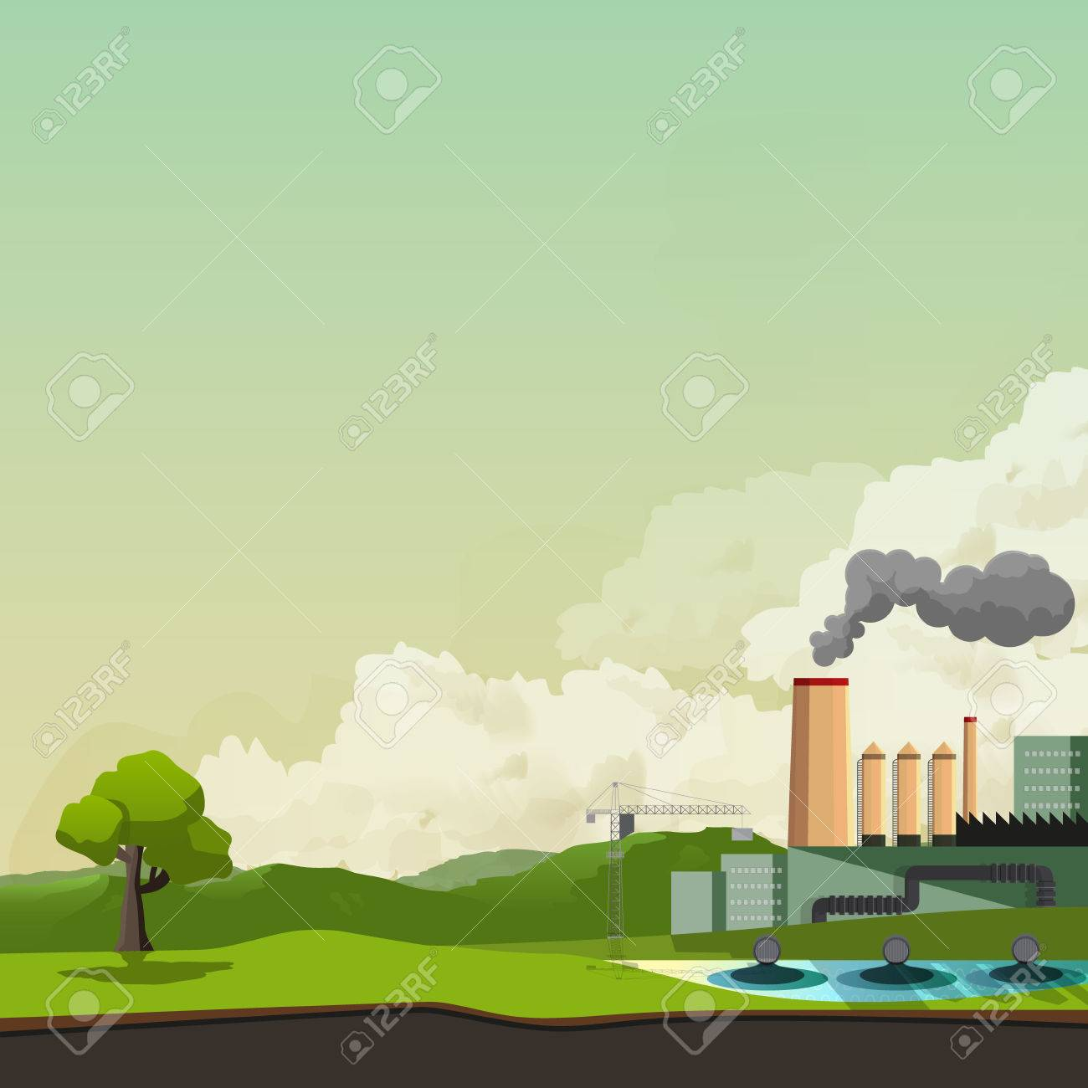
WHAT IS POLLUTION?
Introduction of substances (or energy) that cause adverse changes in the environment and living entities.
POLLUTANTS- Substances that cause pollution.

Slide 4
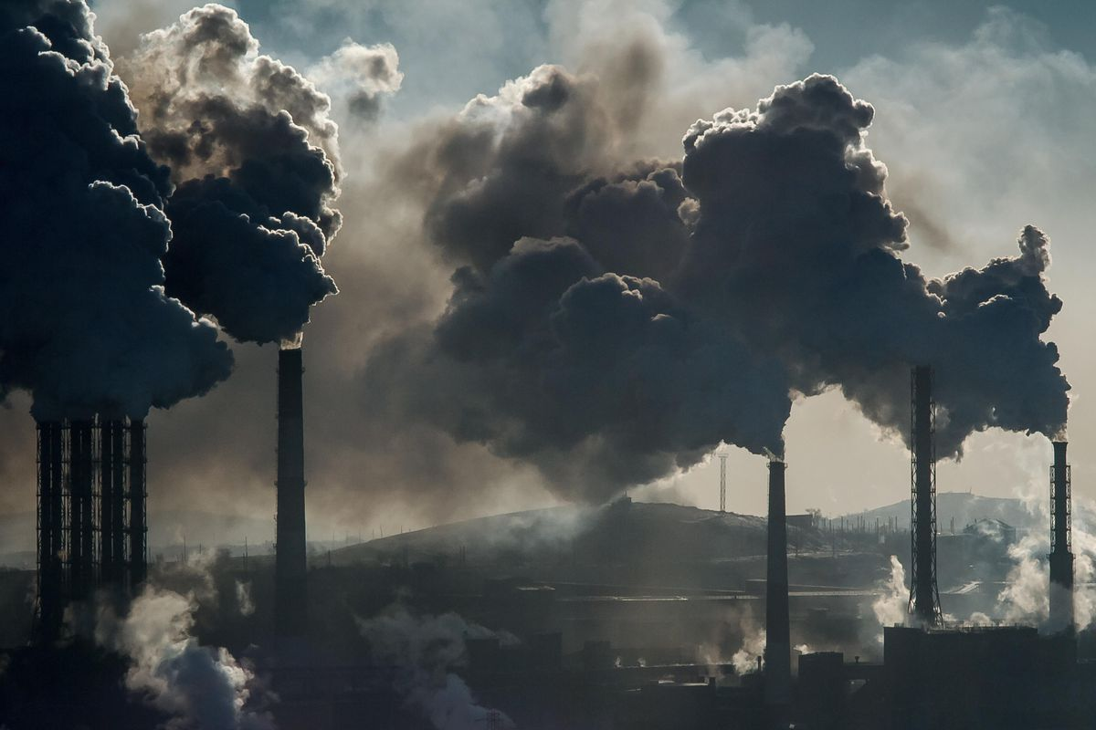
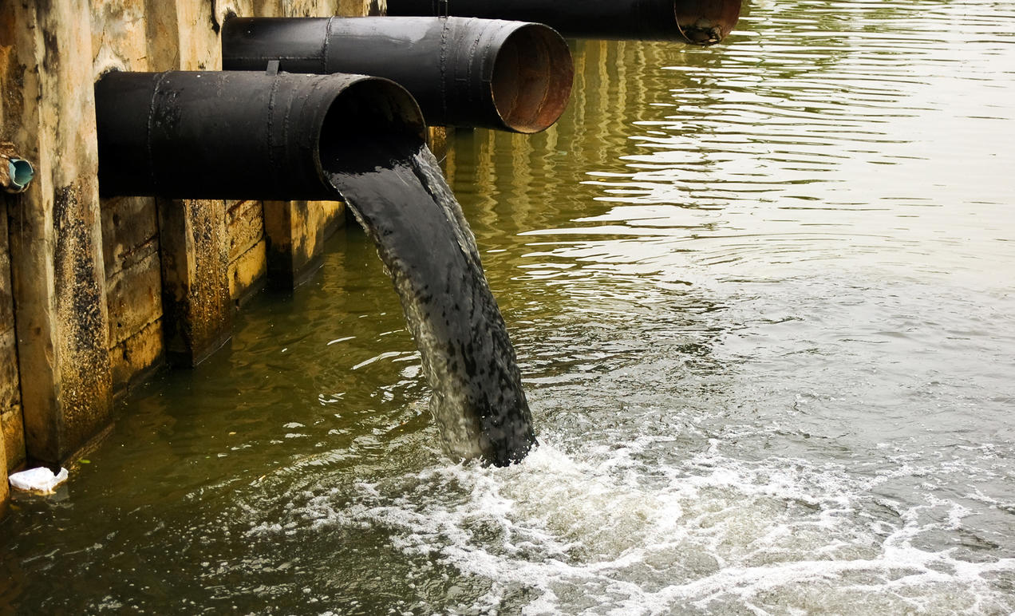


4 MAJOR TYPES OF POLLUTION
WATER POLLUTION
NOISE POLLUTION
AIR POLLUTION
SOIL POLLUTION

Slide 5
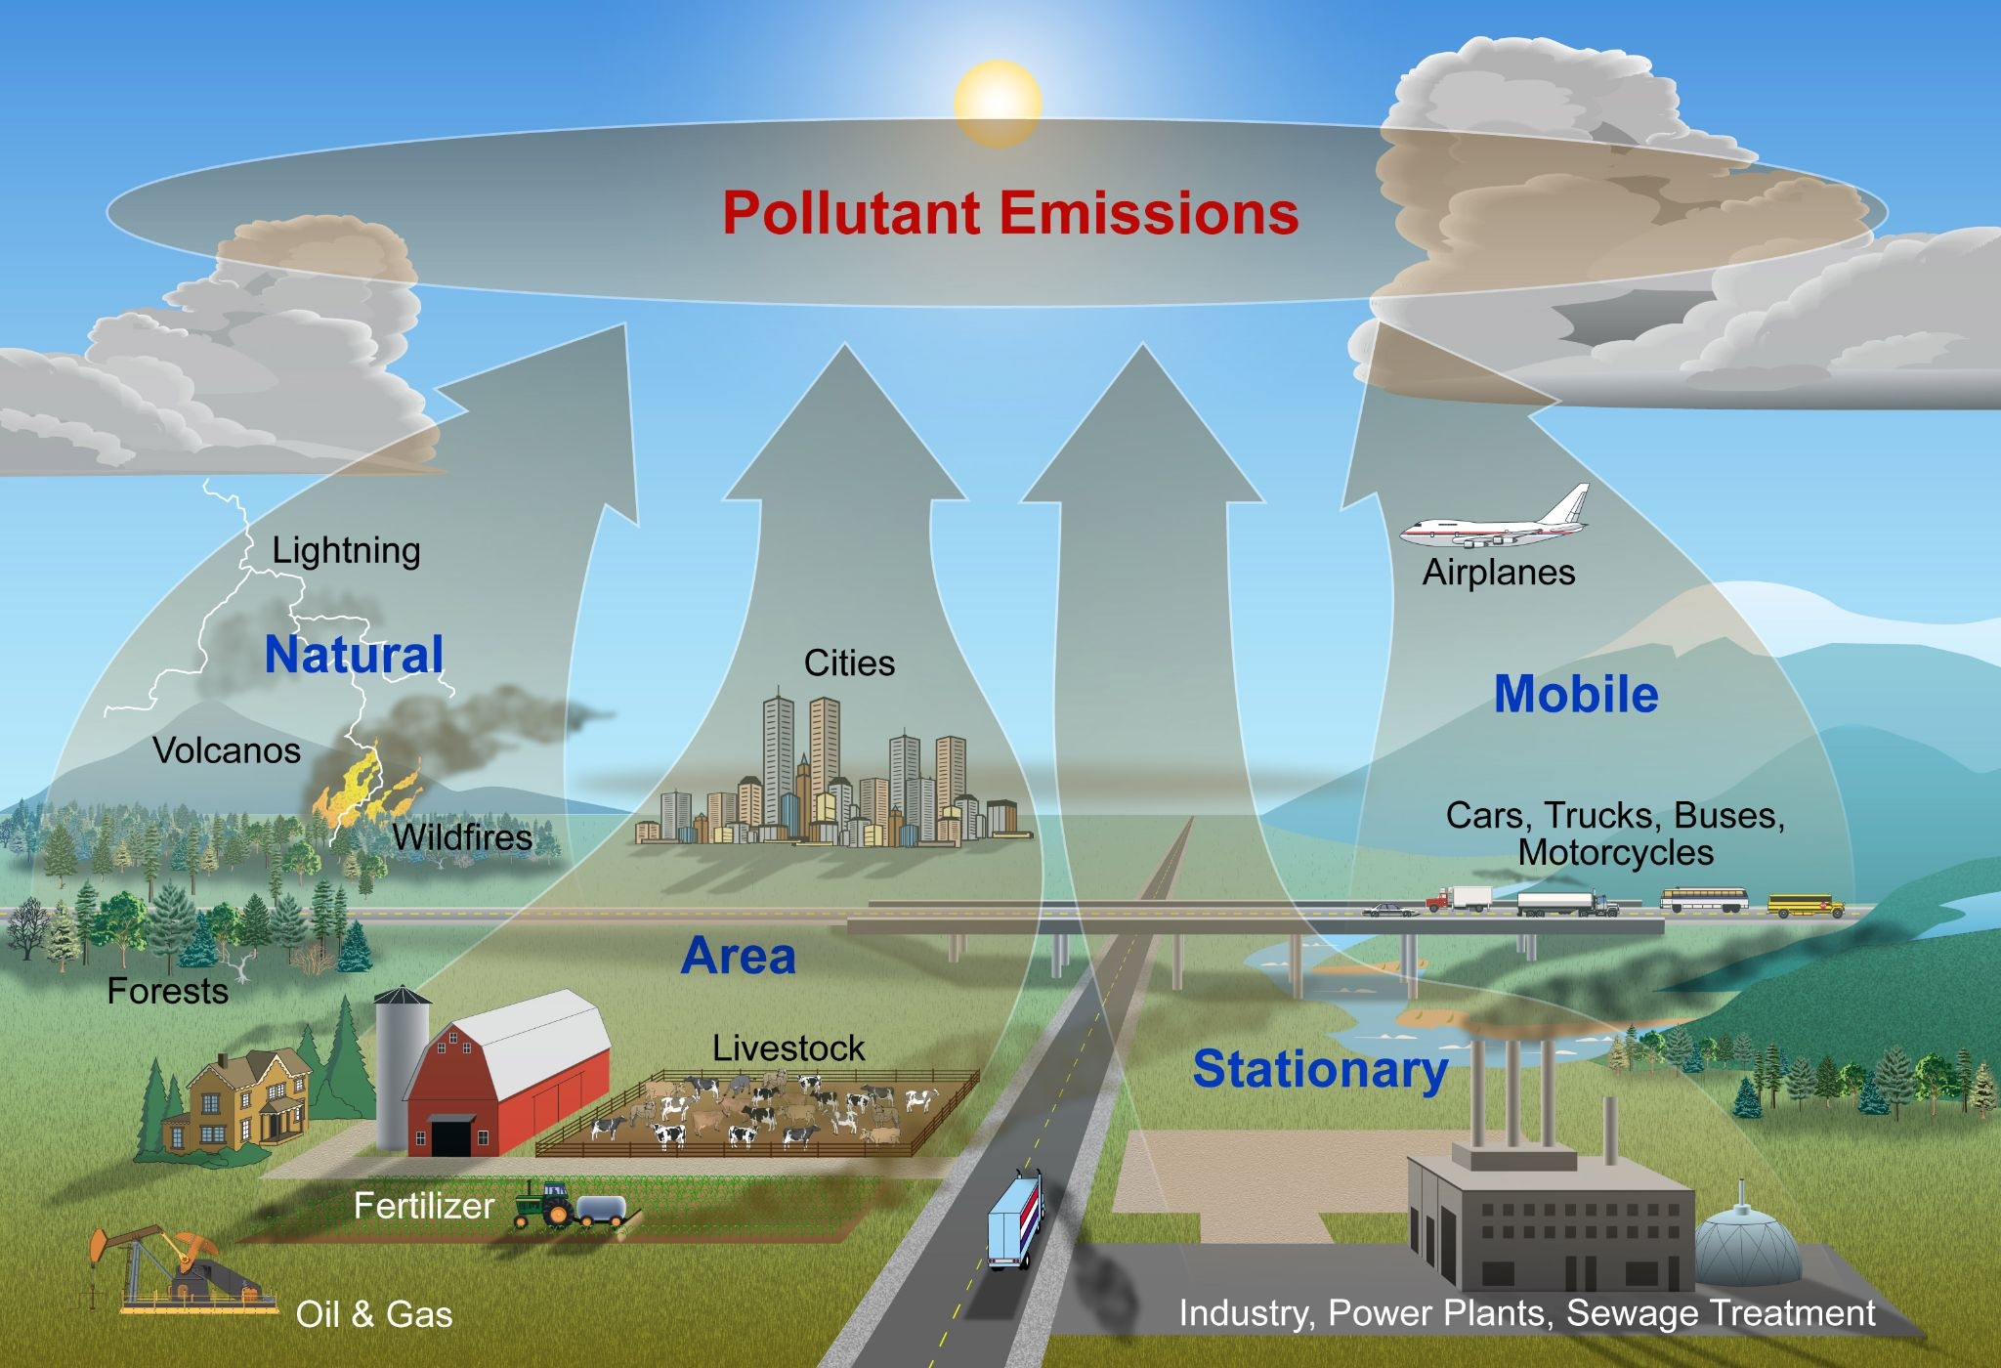
AIR POLLUTION
Release of harmful contaminants (chemicals, toxic gases, particulates, biological molecules, etc.) into the earth’s atmosphere
CAUSES
Burning fossil fuels
Mining operations
Exhaust gases from industries and factories

Slide 6
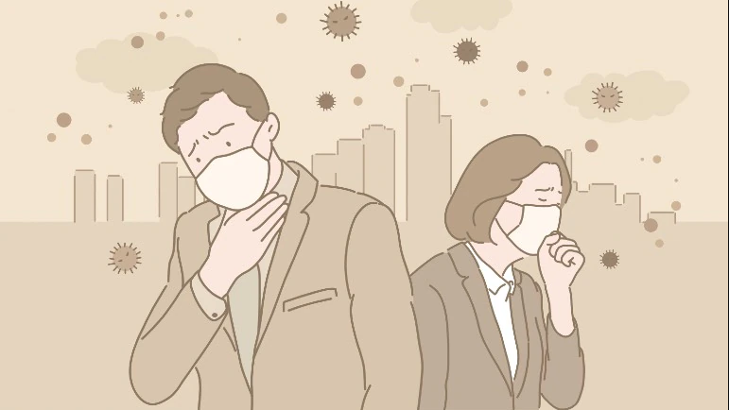
EFFECTS OF AIR POLLUTION
Increased risk of respiratory illness and cardiovascular problems.
Increased risk of skin diseases
May increase the risk of cancer
Global warming
Acid rain
Ozone depletion
Hazards to wildlife

Slide 7
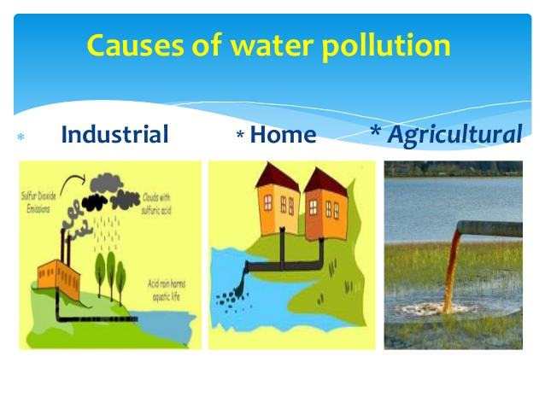
WATER POLLUTION
Occur when toxic pollutants and particulate matter are introduced into water bodies.
CAUSES
Improper sewage treatment
Oil spills
Eutrophication
Dumping solid wastes in water bodies
Disposing untreated industrial sewage into water bodies
Human and animal wastes
Agricultural runoff containing pesticides and fertilisers

Slide 8
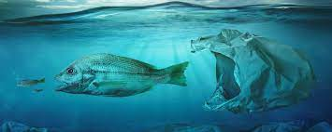
EFFECTS OF WATER POLLUTION
Toxic chemicals can bioaccumulate in living beings
Disruption of the ecosystem
Threats to marine life
Increased risk of water-borne diseases
Increases toxic chemicals (such as mercury) in water bodies
Eutrophication

Slide 9
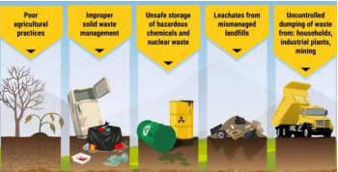
3. SOIL POLLUTION
Refers to the degradation of land due to the presence of chemicals or other man-made substances in the soil.
CAUSES
Improper industrial waste disposal
Oil Spills
Acid rain which is caused by air pollution
Mining activities
Intensive farming and agrochemicals (like fertilisers and pesticides)
Industrial accidents

Slide 10
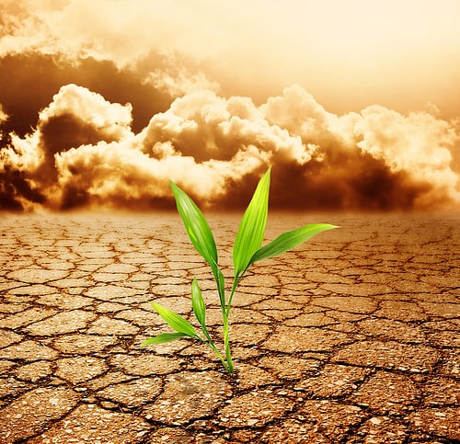
EFFECTS OF SOIL POLLUTION
Loss of soil nutrients, which renders the soil unfit for agriculture
Impacts the natural flora and fauna residing in the soil
Degrades vegetation due to the increase of salinity of the soil
Toxic dust (such as silica dust) can cause respiratory problems or even lung cancer

Slide 11
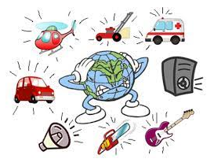
4. NOISE POLLUTION
Excessive amount of noise in the surrounding that disrupts the natural balance.
CAUSES
Industry-oriented noises such as heavy machines, mills, factories, etc.
Transportation noises from vehicles, aeroplanes, etc.
Construction noises
Noise from social events
Household noises

Slide 12
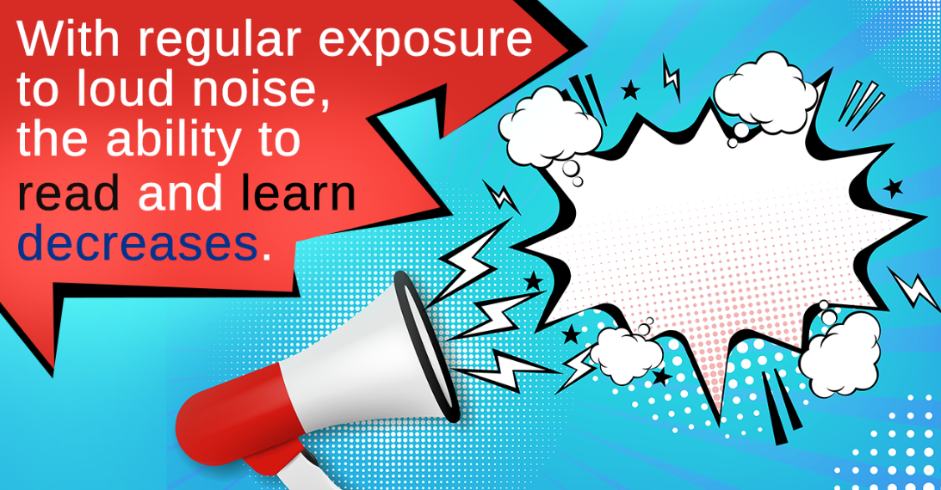
EFFECTS OF NOISE POLLUTION
Hearing loss
Tinnitus
Sleeping disorders
Hypertension (high BP)
Communication problems

Slide 13
POLLUTION PREVENTION
Pollution prevention (P2) is any practice that reduces, eliminates, or prevents pollution at its source.
IN THE ENERGY SECTOR
increasing efficiency in energy use;
use of environmentally benign fuel sources.
IN THE AGRICULTURAL SECTOR
Reducing the use of water and chemical inputs;
Adoption of less environmentally harmful pesticides or cultivation of crop strains with natural resistance to pests
Protection of sensitive areas.

Slide 14
IN THE INDUSTRIAL SECTOR
Modifying a production process to produce less waste
Using non-toxic or less toxic chemicals as cleaners, degreasers and other maintenance chemicals
Implementing water and energy conservation practices
Reusing materials such as drums and pallets rather than disposing of them as waste
IN HOMES AND SCHOOLS
Using reusable water bottles instead of throw-aways
Automatically turning off lights when not in use
Repairing leaky faucets and hoses
Switching to "green" cleaners

Slide 15
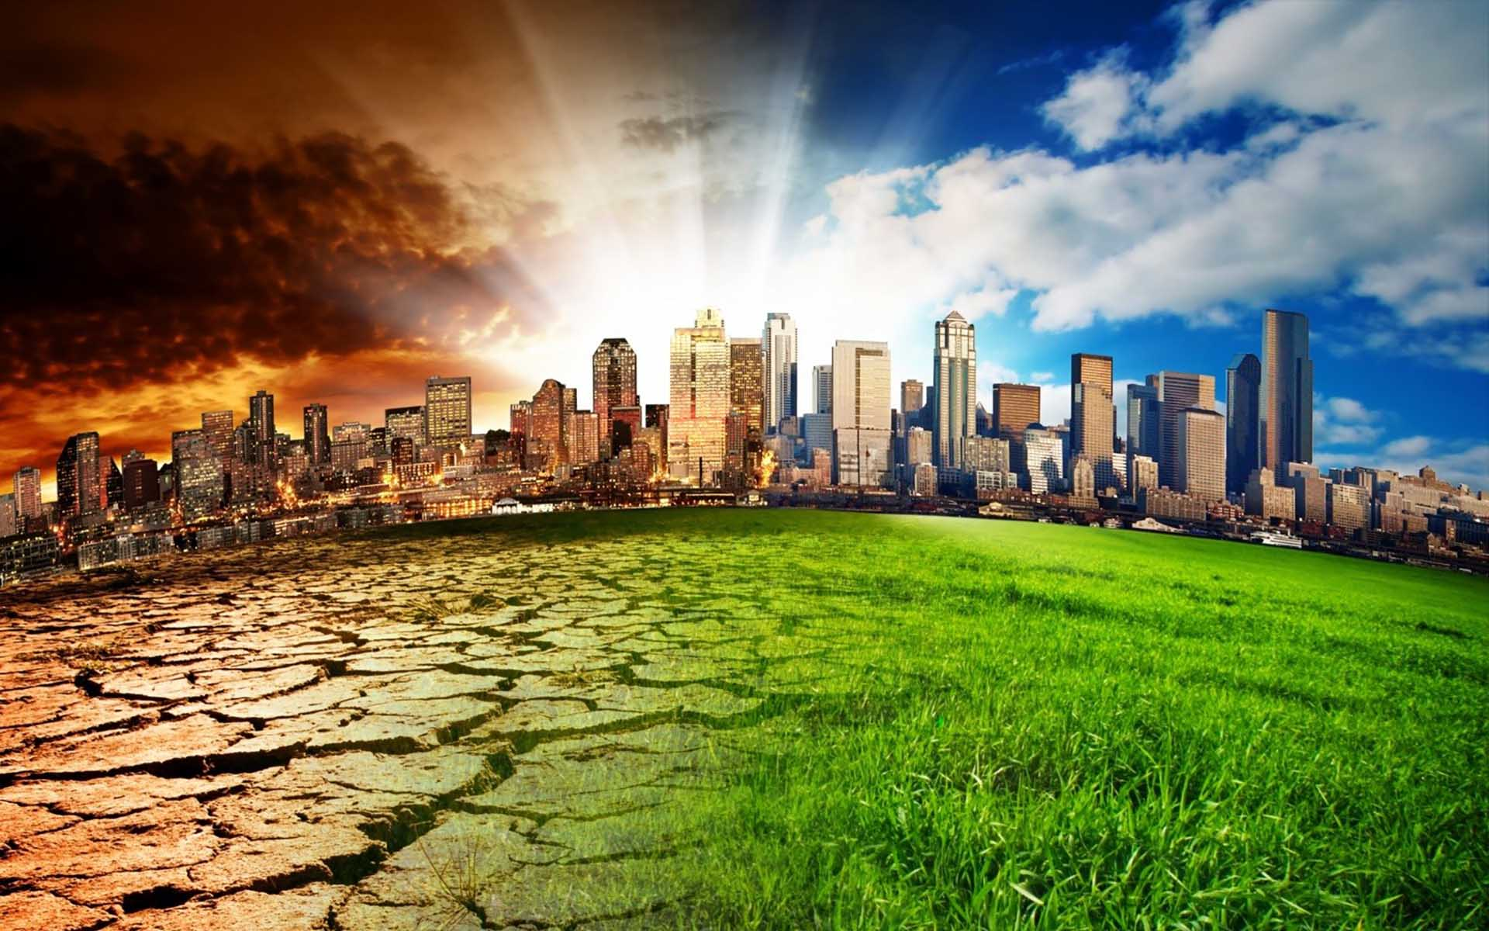
Thank You

